Slide 1
Eclipse and ROS
Setting up a workspace and Eclipse projects

Slide 2
Catkin workspace
rerun catkin build with the following bash commands:
or easy use the bash script from:
https://github.com/neumann89/ros_hello_world/blob/master/bin/make-eclipse-projects.sh
catkin build --force-cmake -G"Eclipse CDT4 - Unix Makefiles"
ROOT=$PWD
cd build
for PROJECT in `find $PWD -name .project`; do
DIR=`dirname $PROJECT`
echo $DIR
cd $DIR
awk -f $(rospack find mk)/eclipse.awk .project
> .project_with_env && mv .project_with_env .project
done
cd $ROOT

Slide 3
Eclipse - Launcher
start Eclipse with your bash environment settings:
$ bash -i -c "/path/to/eclipse"
change Excec line in a desktop launcher (icon), for example in ~/.local/share/applications/eclipse.desktop
Exec=bash -i -c "/path/to/eclipse"

Slide 4
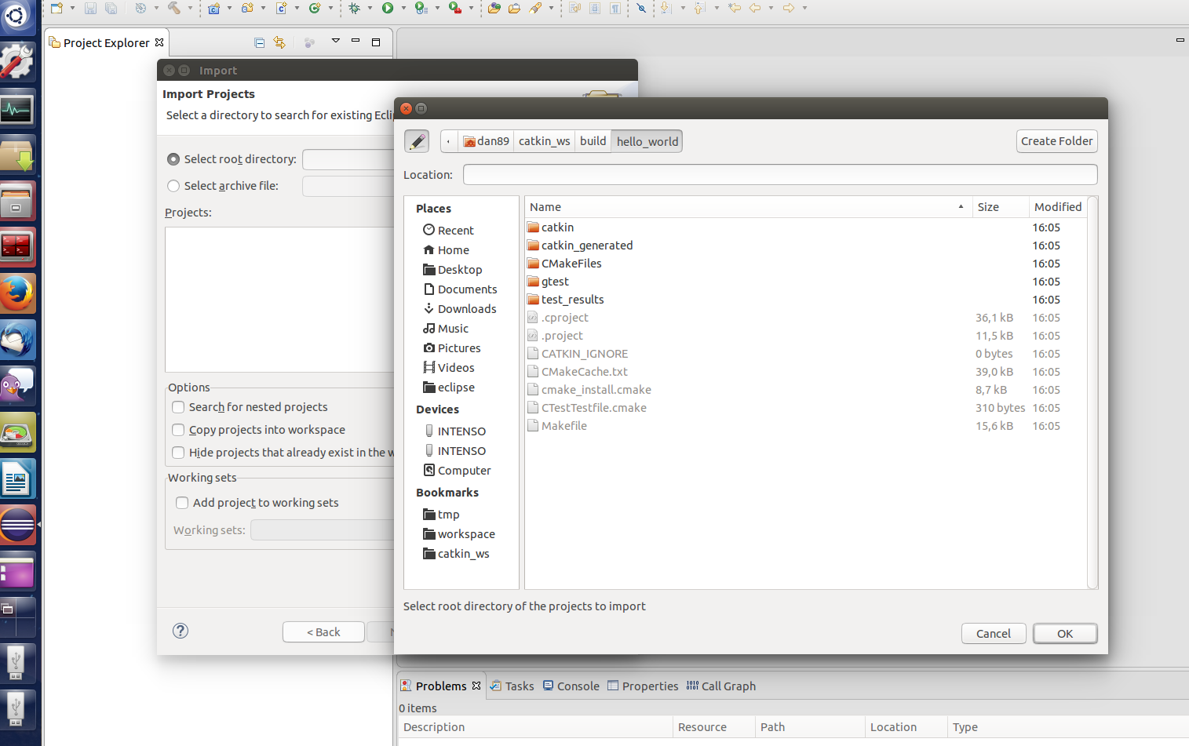
Eclipse - Import Project
go to File → Import… → Existing Projects into Workspace

Slide 5
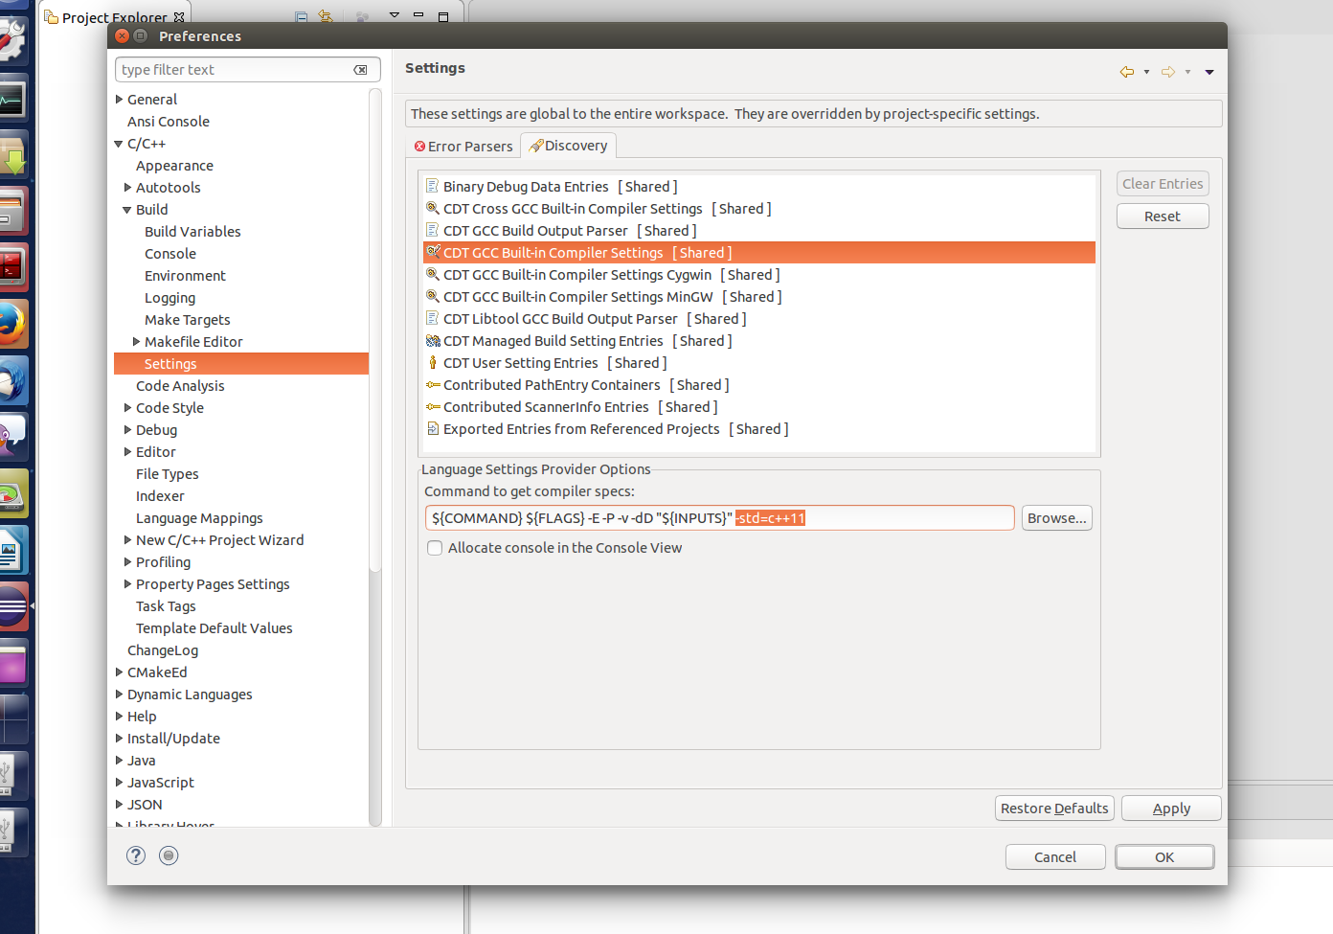
Eclipse - OPTIONAL C++11
go to Window → Preferences and add the -std=c++11 flag

Slide 6
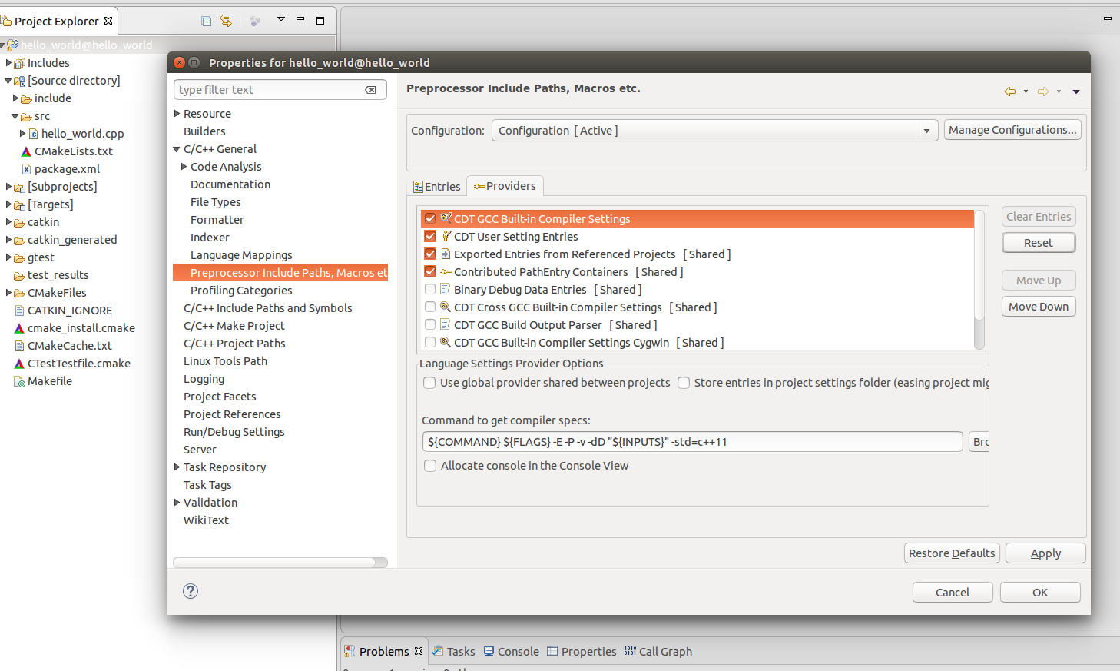
Eclipse - Preprocessor Settings
right click on project → Properties
perhaps you have to right click on project → Index → Rebuild

Slide 7
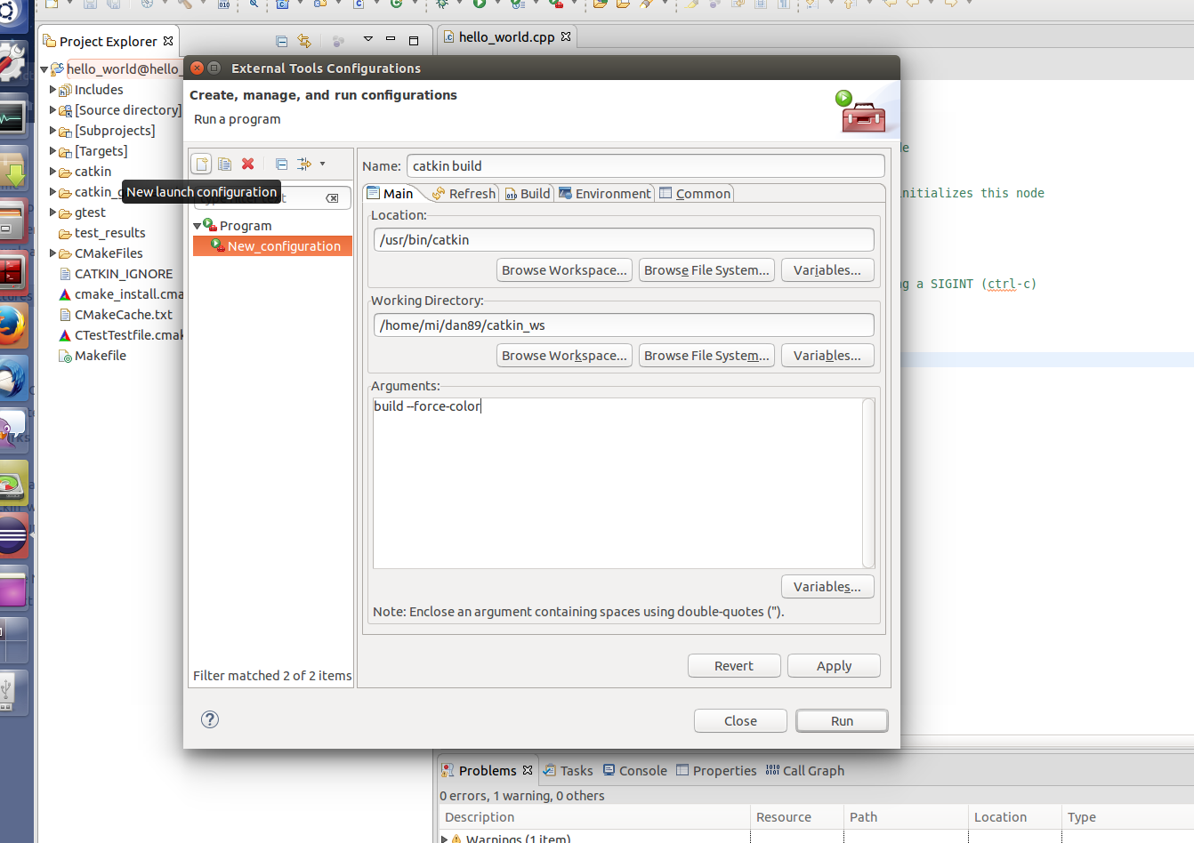
Eclipse - Run catkin
go to Run → External Tools → External Tools Configurations...
recommendation: install Ansi Console Plugin

